Slide 1
NMBM Algoa Recon. Meeting
Groundwater 27 March 2013
Re-cap on groundwater areas
Groundwater license applications
Progress on drilling contract

Slide 2
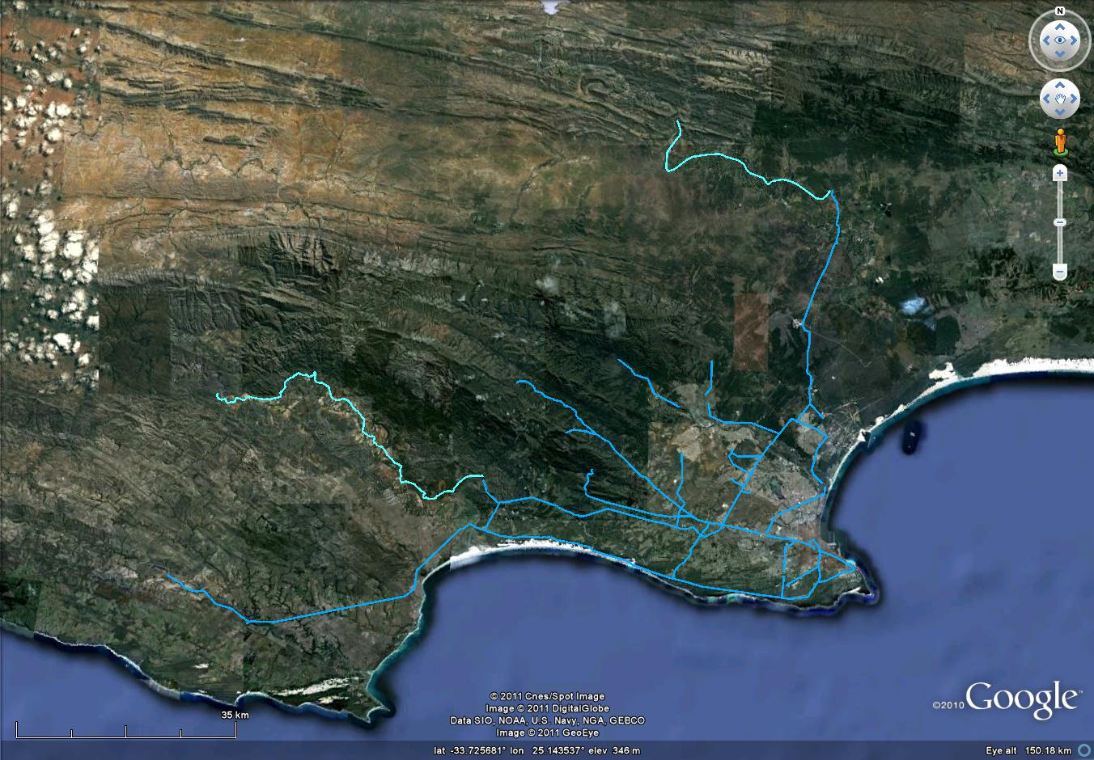
Groundwater target areas
Yellow: Ready to drill
White: Provisional assessment
Red: Discarded
Green: Future assessment
Zuurberg Fault
Gamtoos Fault
Coega Fault
Schelmhoek
dune fields
License Apl: 26 Ml/day
Kruisrivier/
Rooihoogte
Humansdorp
Area
Moregrove Fault
Churchill Dam
License Apl.: 13 Ml/day
Maitland
Mines
Chelsea-Noordhoek
Fault
Driftsands

Slide 3
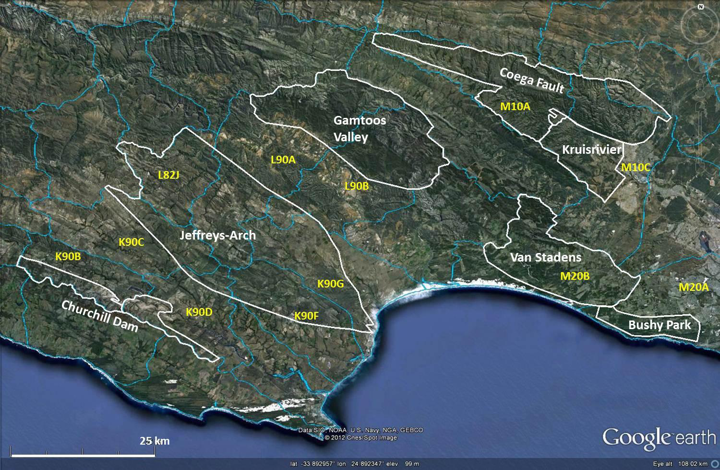
Groundwater areas with estimated exploitable yields
(aquifer yields are much higher)
8 M m³/a
3 M m³/a
0.5 M m³/a
7 M m³/a
4 M m³/a
3 M m³/a
Total: 29.5 M m³/a
(20.4 – 34.0 M m³/a)
4 M m³/a

Slide 4
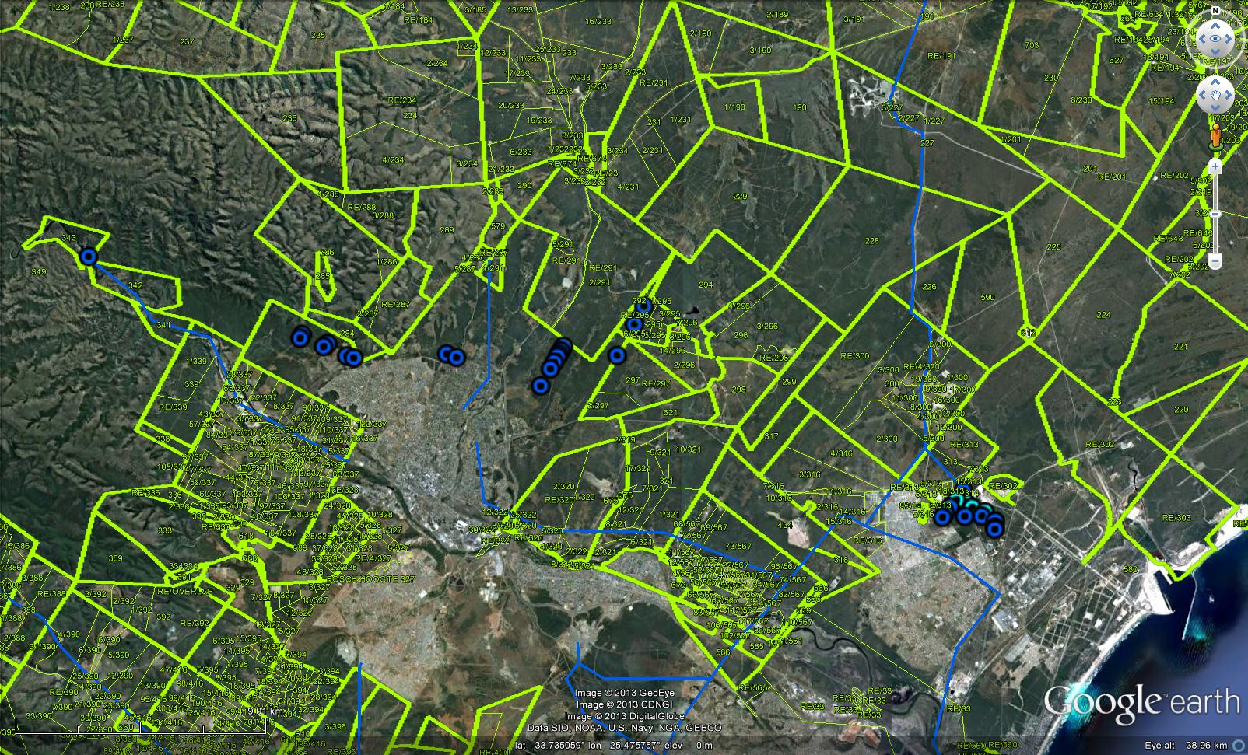
Coega Fault Borehole Sites
Coega Fault System
All borehole have been sited
License application: Submitted - 26 Ml/day
9 km

Slide 5
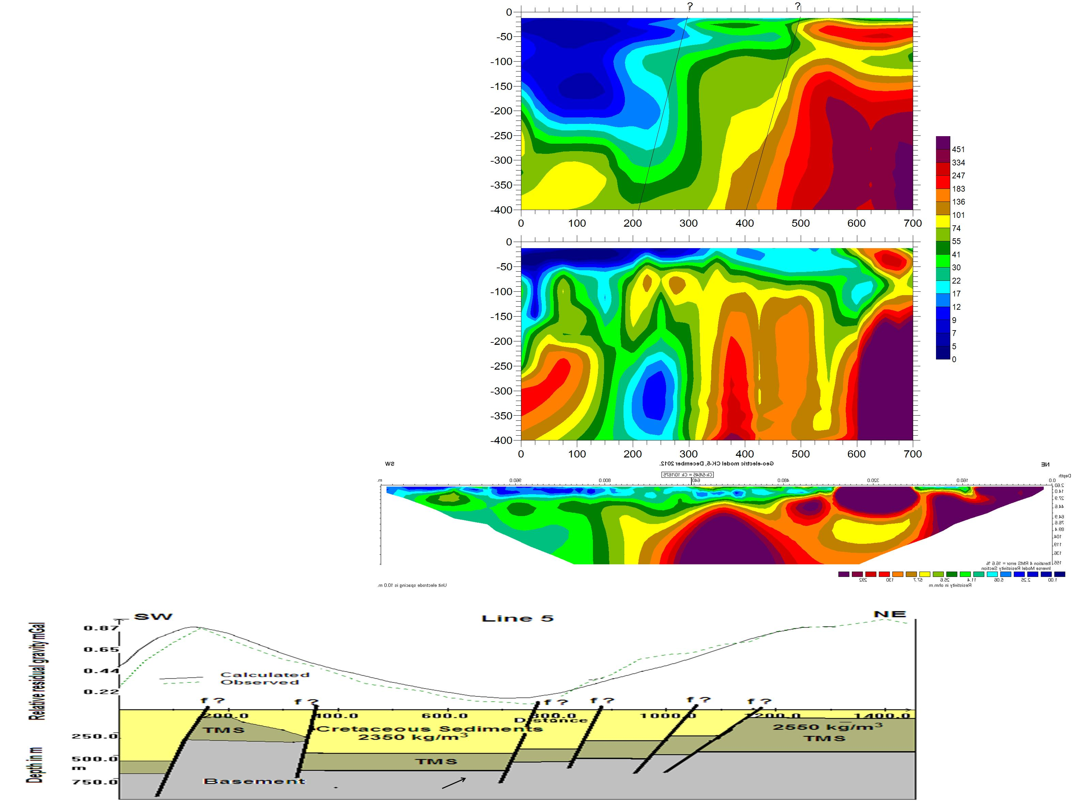
Magnetotelluric Determinant Model
Magnetotelluric Invariant Model
Resistivity Model
Gravity Model

Slide 6
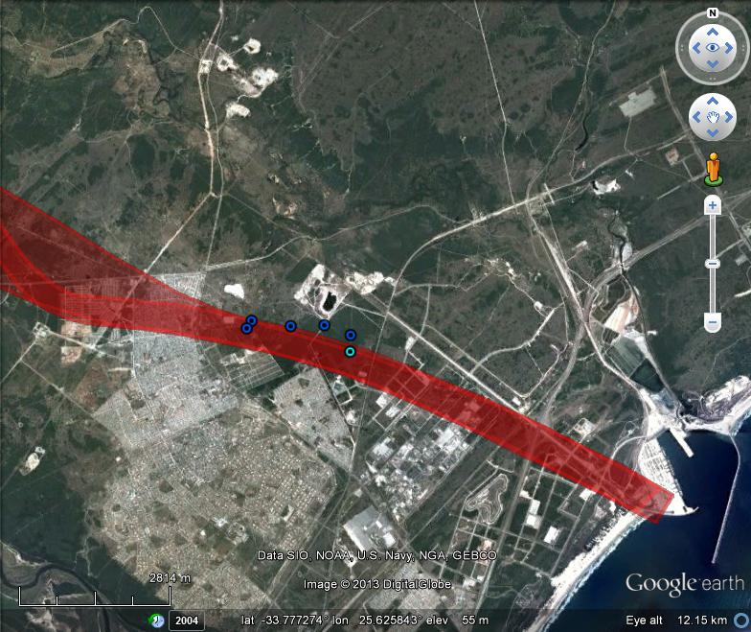

Slide 7
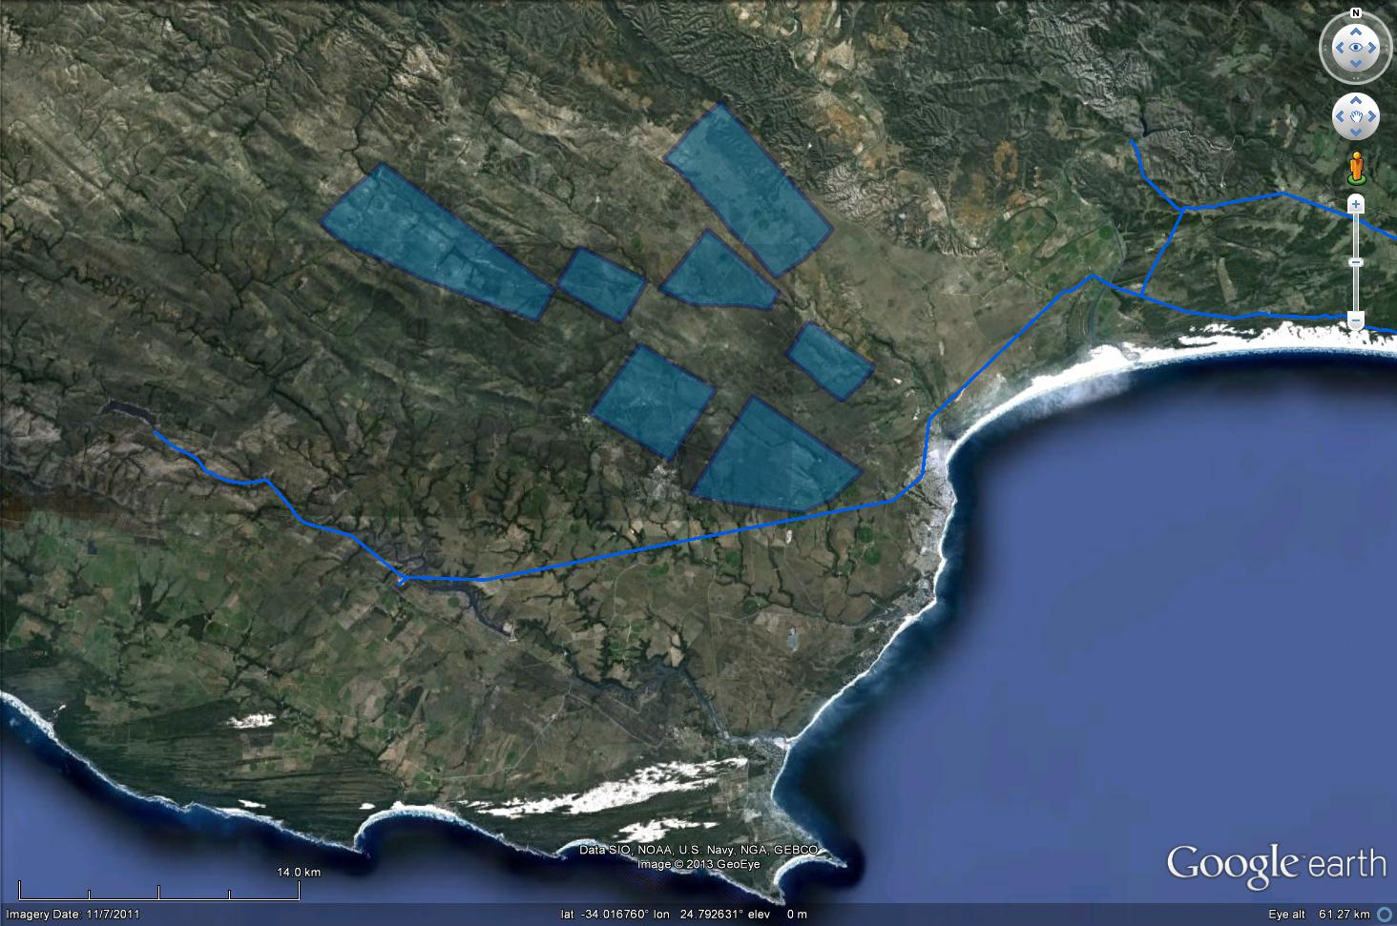
Humansdorp provisional yield estimates
Zuurbron
(1.3-2.8 Ml/day)
Green Valley
(5.6-10 Ml/day)
Honeyville
(0.9-1.4 Ml/day)
Weltevreden (1.7-2.8 Ml/day)
Rooihoek
(2.2-3.5 Ml/day)
Rondebosch
(1.7-2.8 Ml/day)
Uitsig (2.2-3.5 Ml/day)
Total
~15 – 25 Ml/day
~5.5 – 9 M m³/a
14 km

Slide 8
Driller Appointment
Re-submit the SA Rockdrill appointment
Re-tender
Piggyback on the Oudtshoorn tender
Use the DWA Term Tender

Slide 9
Schelmhoek dune fields
Potential sites for sand filtration of waste water from the Fishwater Flats WWTW
Expected capacity: 45 – 50 Ml/day

Slide 10
Potential sites for sand filtration of waste water from the Fishwater Flats WWTW prior to its re-use
Ricky Murray (Groundwater Africa) & Marc Goedhart (Kainos South Africa)
November 2012
Area | Owner | Potential based on sand thickness | Key findings | Estimated waste water treatment capacity (Ml/day)
A & B | Not established | None | 1. Average sand thickness <5m. 2. Earmarked for additional habour development. | N/A
C | Transnet (Reclamation Dump) | Moderate | 1. Sand thickness: ~25-30m. 2. Mainly fine- to medium-grained aeolian and pebbly marine sand, but also silt. 3. Dump is not in use. 4. Concern over stability if saturated with water. | Min: 2.5 Max: 10
D & E | CDC | Marginal | 1. Average sand thickness may be acceptable (max 10m; dunes up to 20m). 2. CDC has development plans for these areas linked to those of Transnet / National Ports Authority, but possibly not for all parts. These plans are currently being refined and upgraded. 3. Such developments will require sand removal/ mining from these areas. 4. Accessibility in parts of Areas E & F is problematic due to thick bush. | Area D Min: 2.5 Max: 20 Area E Min: 2 Max: 16
F | PPC mainly and CDC in south | None | 1. Northern area, owned by PPC, is earmarked for future sand mining. Southern part, owned by CDC, has a PPC mining permits over it. | Min: 15 Max: 45+

Slide 11
Colchester Dune Field: Min. 20; Max. >45 Ml/day Alexandria Dune Field (west): Min. & Max >45 Ml/day

Slide 13
Current key tasks
Appoint a driller
Assess waste water sand filtration potential north of Ngqura harbour (Schelmhoek dune fields)

